Slide 1



UNIT 6 Town and coutryside
Look back 6

Slide 2
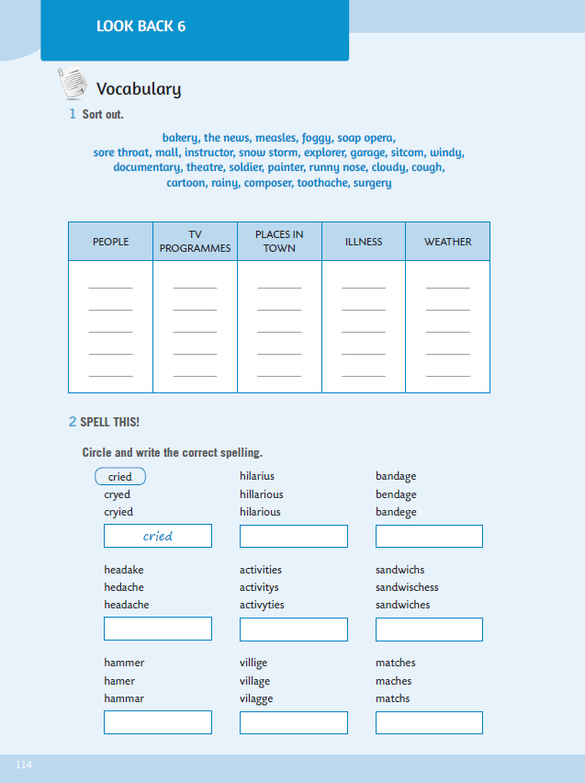
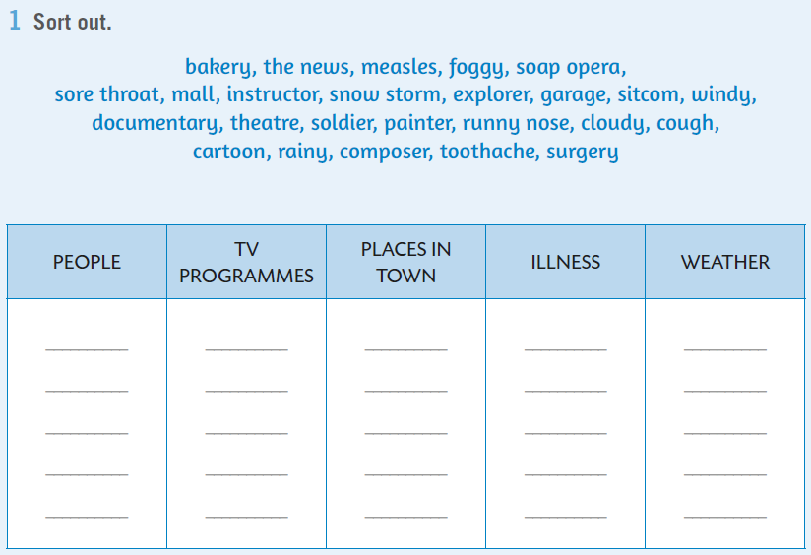
WB, p. 114. In task 1, you need to sort out the words. U 1. zadatku razvrstaj riječi u navedene kategorije – ljudi, TV programi, mjesta u gradu, bolesti i vrijeme.
the news
bakery
measles
foggy

Slide 3
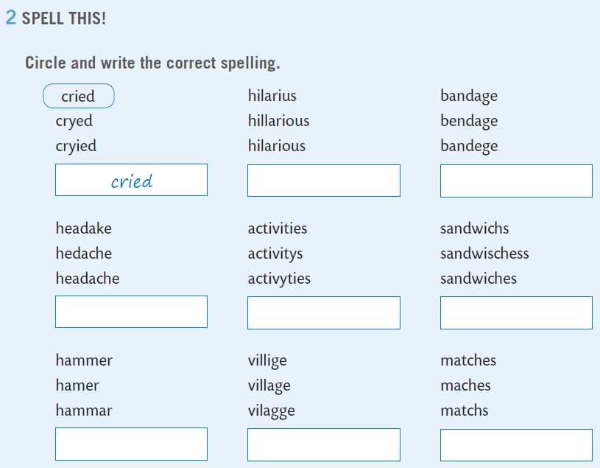

Next task deals with spelling. You have to circle and write the correct spelling.
hilarious

Slide 4
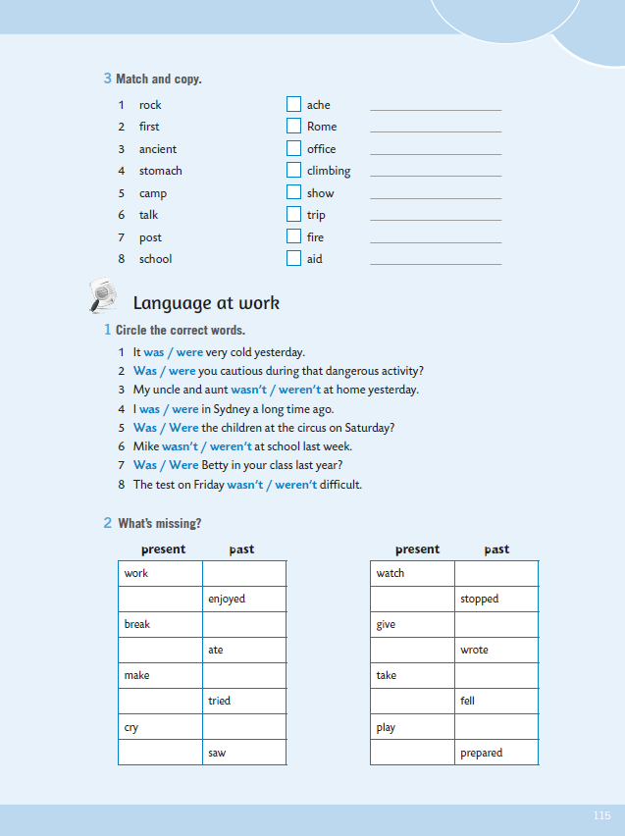
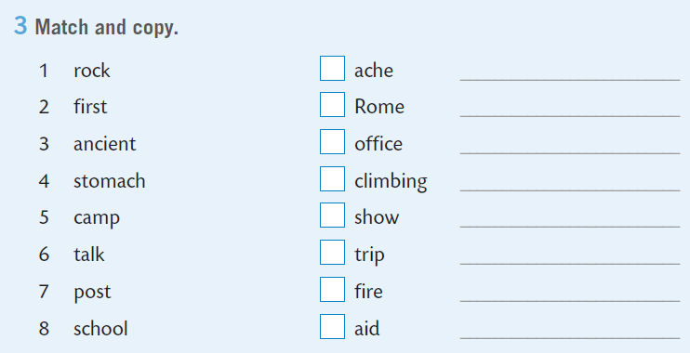
Match and copy the expressions in task 3.
rock climbing
1

Slide 5
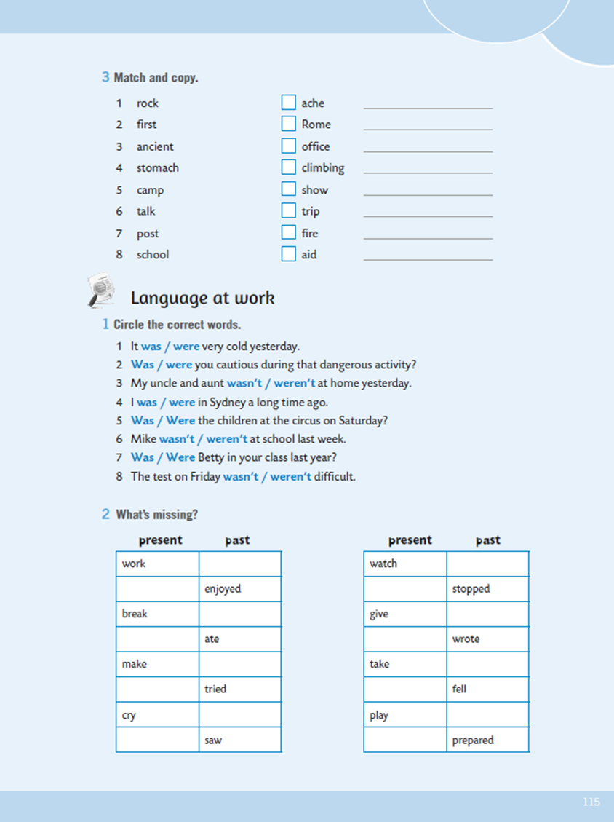
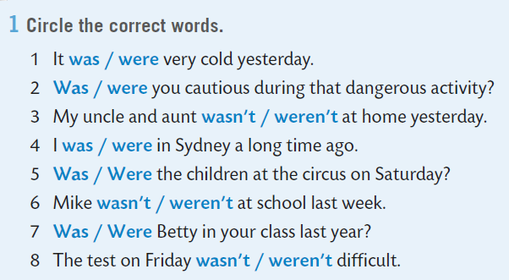
Circle the correct word.
You can do the task here:
https://www.e-sfera.hr/dodatni-digitalni-sadrzaji/016716f3-cb6f-4d17-b8e1-4ea309889f9d/assets/interactivity/kviz_6/index.html

Slide 6
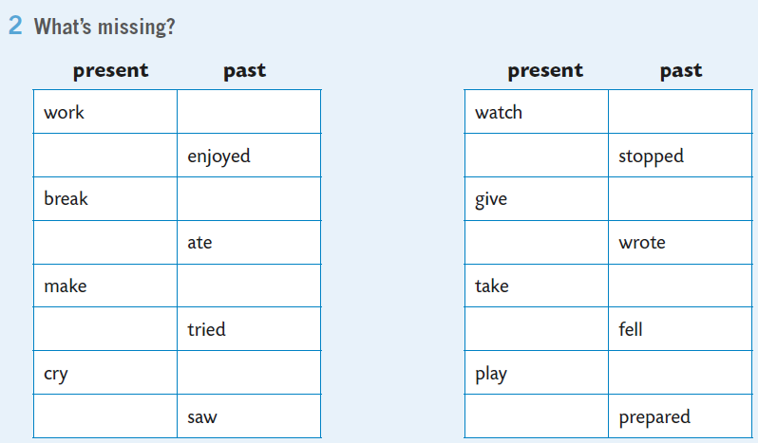
What’s missing?
worked
enjoy
broke

Slide 7
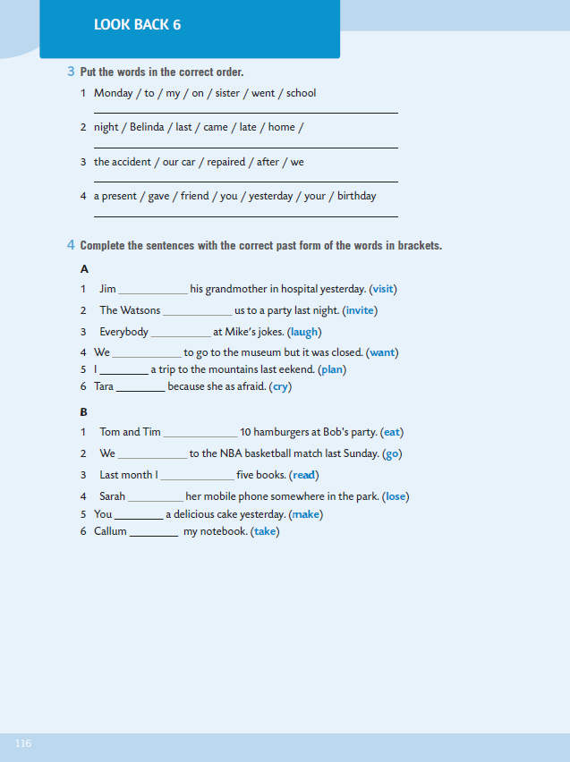
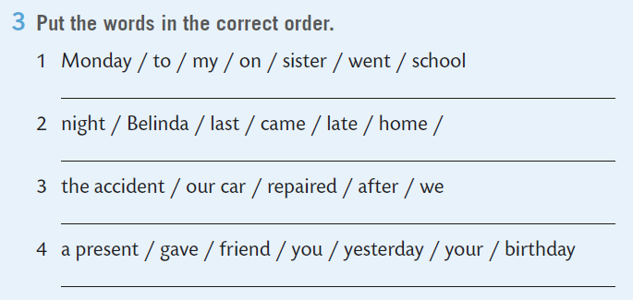
Put the words in the correct order.
My sister went to school on Monday.
Belinda came home late last night.

Slide 8
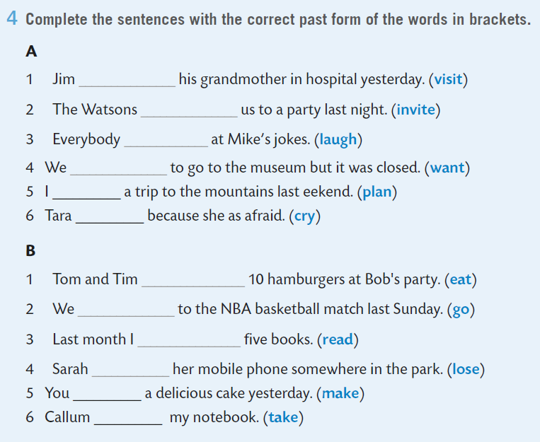
Complete the sentences with the correct past form of the words in brackets.
visited
invited
ate
went

Slide 9
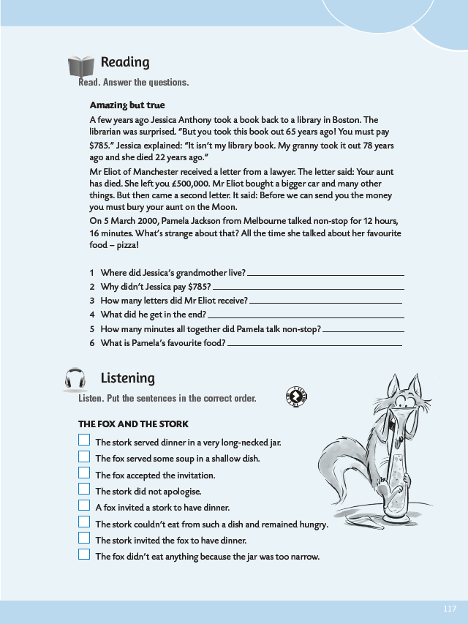
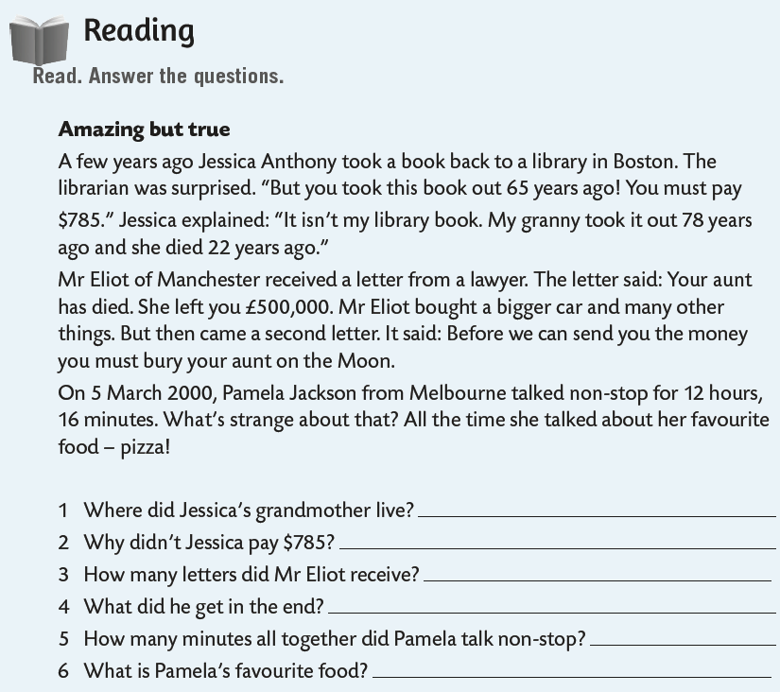
Read. Answer the questions.
1 Jessica's grandmother lived in America.
2 Jessica didn't pay $785 because her grandmother had taken out the book from the library.
3 Mr Eliot received two letters.
4 In the end he got nothing.
5 Pamela talked 736 minutes non-stop.
6 Pamela's favourite food is pizza.

Slide 10
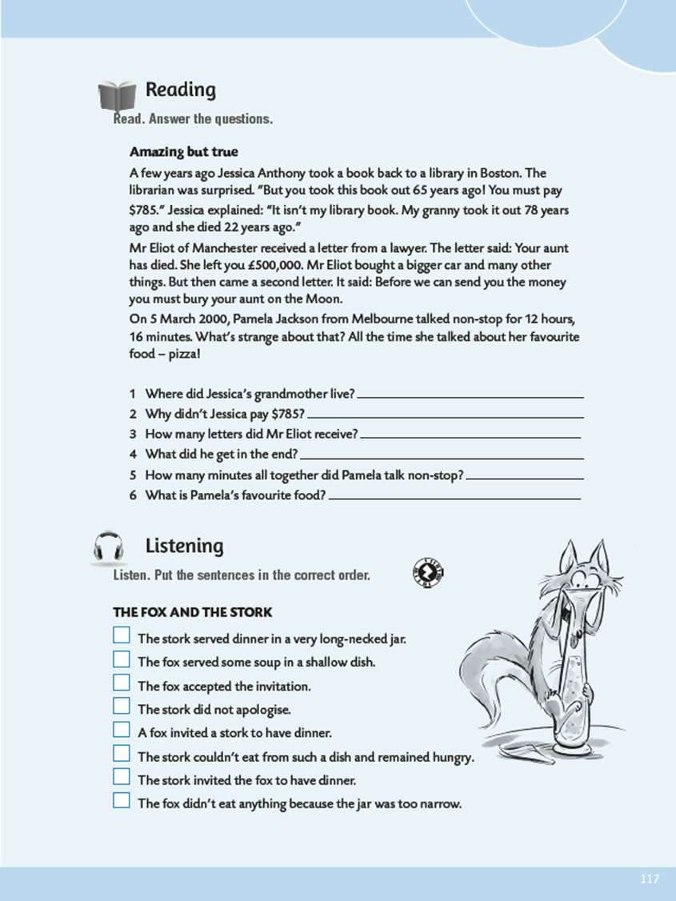
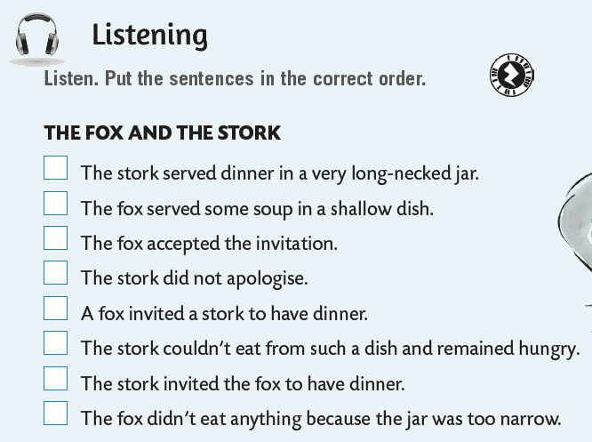

In the listening section, listen and put the sentences in the correct order. https://www.e-sfera.hr/dodatni-digitalni-sadrzaji/016716f3-cb6f-4d17-b8e1-4ea309889f9d/assets/audio/look_back_6-stork.mp3
6
2
5
8
1
3
4
7

Slide 11
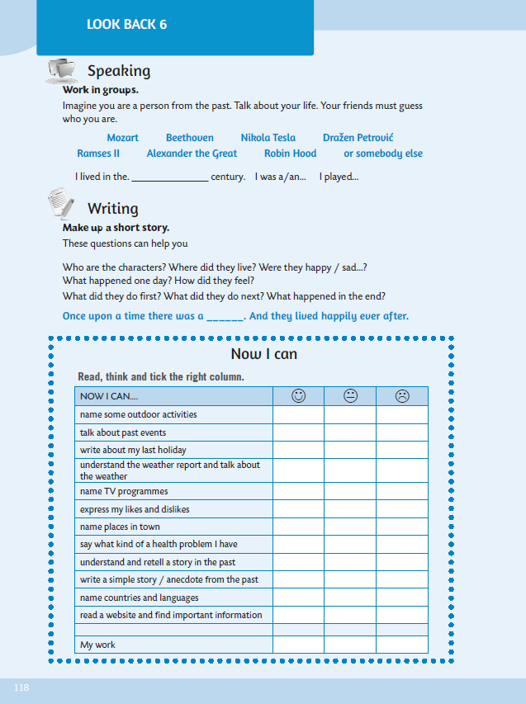
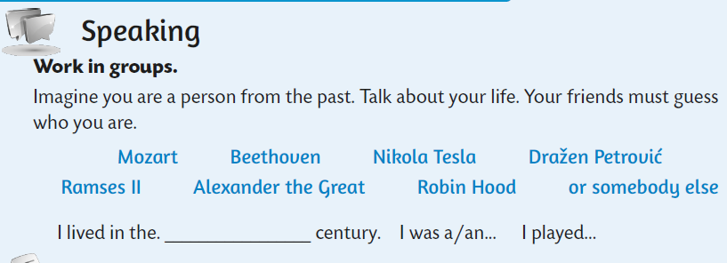
Imagine you are a person from the past. Talk about your life. Your friends must guess who you are.

Slide 12
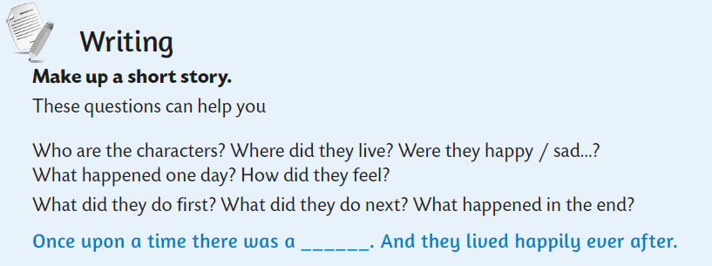
Make up a short story.
Once upon a time there was a beautiful princess who lived in a kingdom far away.

Slide 13
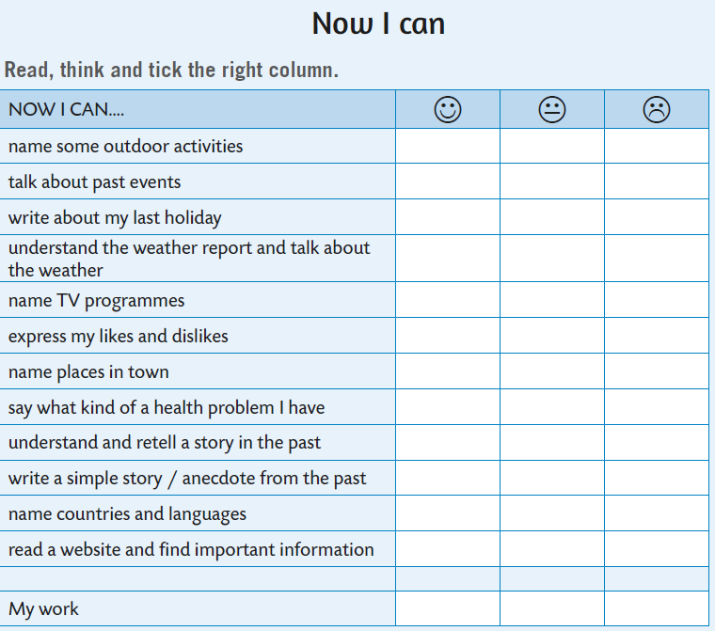



Now you can self-evaluate. Read the sentences, think and tick the right column.
- imenovati vanjske aktivnosti
- razgovarati o događajima u prošlosti
- pisati o svom prethodnom odmoru/praznicima
- razumjeti vremensku prognozu i razgovarati o vremenu
- imenovati vrste TV emisija
- izraziti sviđanje i nesviđanje
- imenovati mjesta u gradu
- izreći kakve zdravstvene probleme imamo
- razumjeti i prepričati kratku priču u prošlosti
- pisati jednostavnu priču u prošlosti
- imenovati zemlje i jezike
- pročitati webstranicu i pronaći bitne informacije

